Slide 1
Chicago Crime Analysis
Springboard Data Scientist Career Track Capstone Project 1
Xiangyu Chen, Spring 2018

Slide 2
Why do we care about crime analysis?
Identify crime zones/hotspots for law enforcement
Improve public safety in the city
Gain insights into correlations between crime rates and social problems

Slide 3
Why Chicago?
Data set is readily available and has rich information
Chicago has been plagued by crime problems lately
Very large city (3rd in the U.S.) and worth investigating

Slide 4
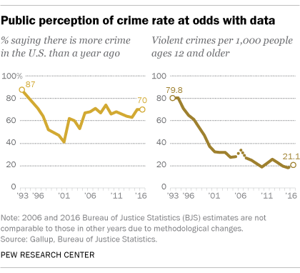
What do people think about crime rates?
http://www.pewresearch.org/fact-tank/2018/01/30/5-facts-about-crime-in-the-u-s/ft_18-01-26_crimetrends_perception/

Slide 5
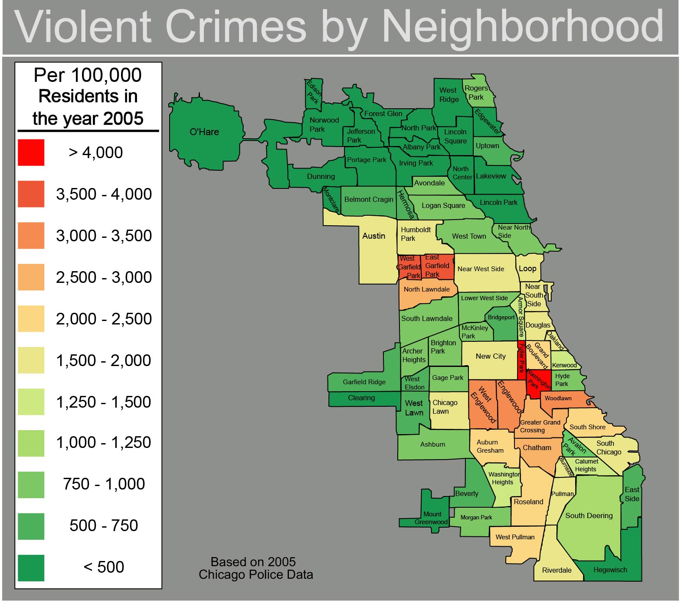
Chicago crimes in all communities in 2015
Source: Wikepedia commons

Slide 6
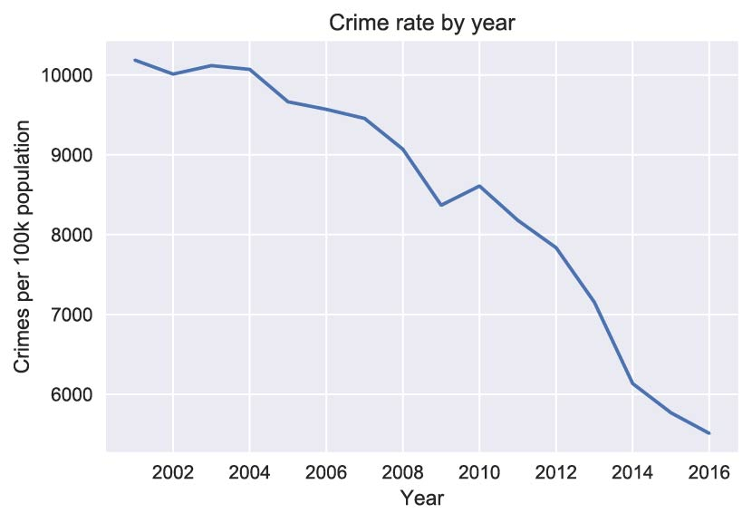
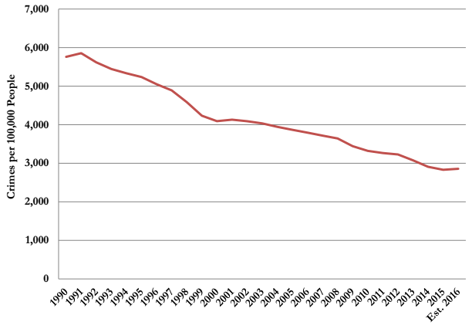
Overall crime rates in Chicago decreased and also country wide
Chicago
United States
Source: Brennan Center for Justice website

Slide 7
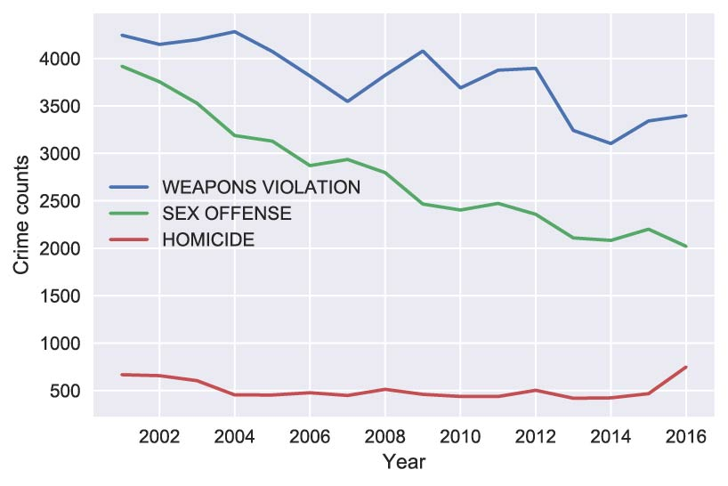
Homicide and Weapons Violations increased

Slide 8
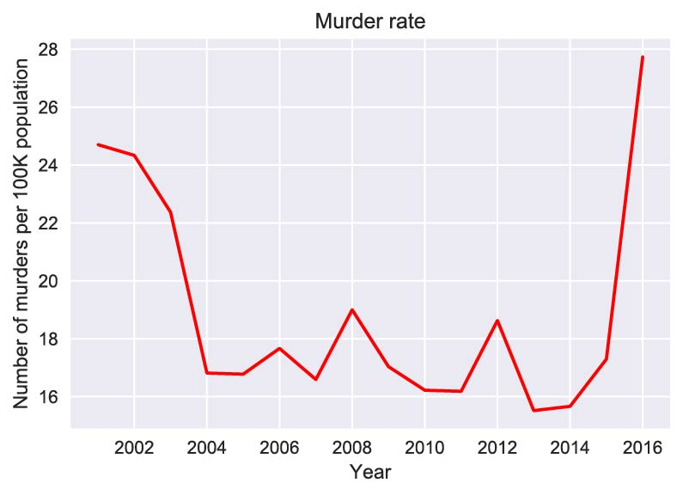
Abnormally high murder rate in 2016

Slide 9
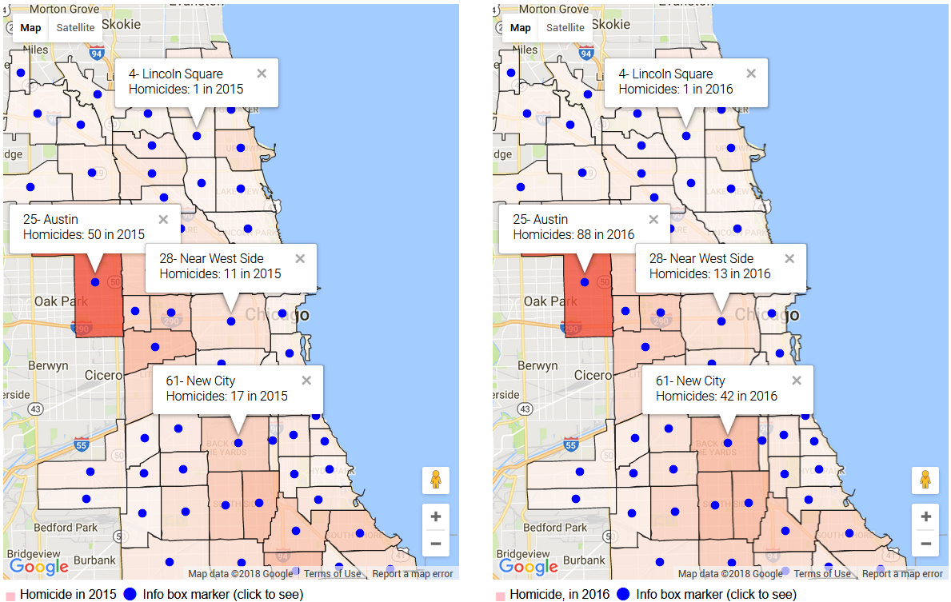
Where did all the murders happen?

Slide 10
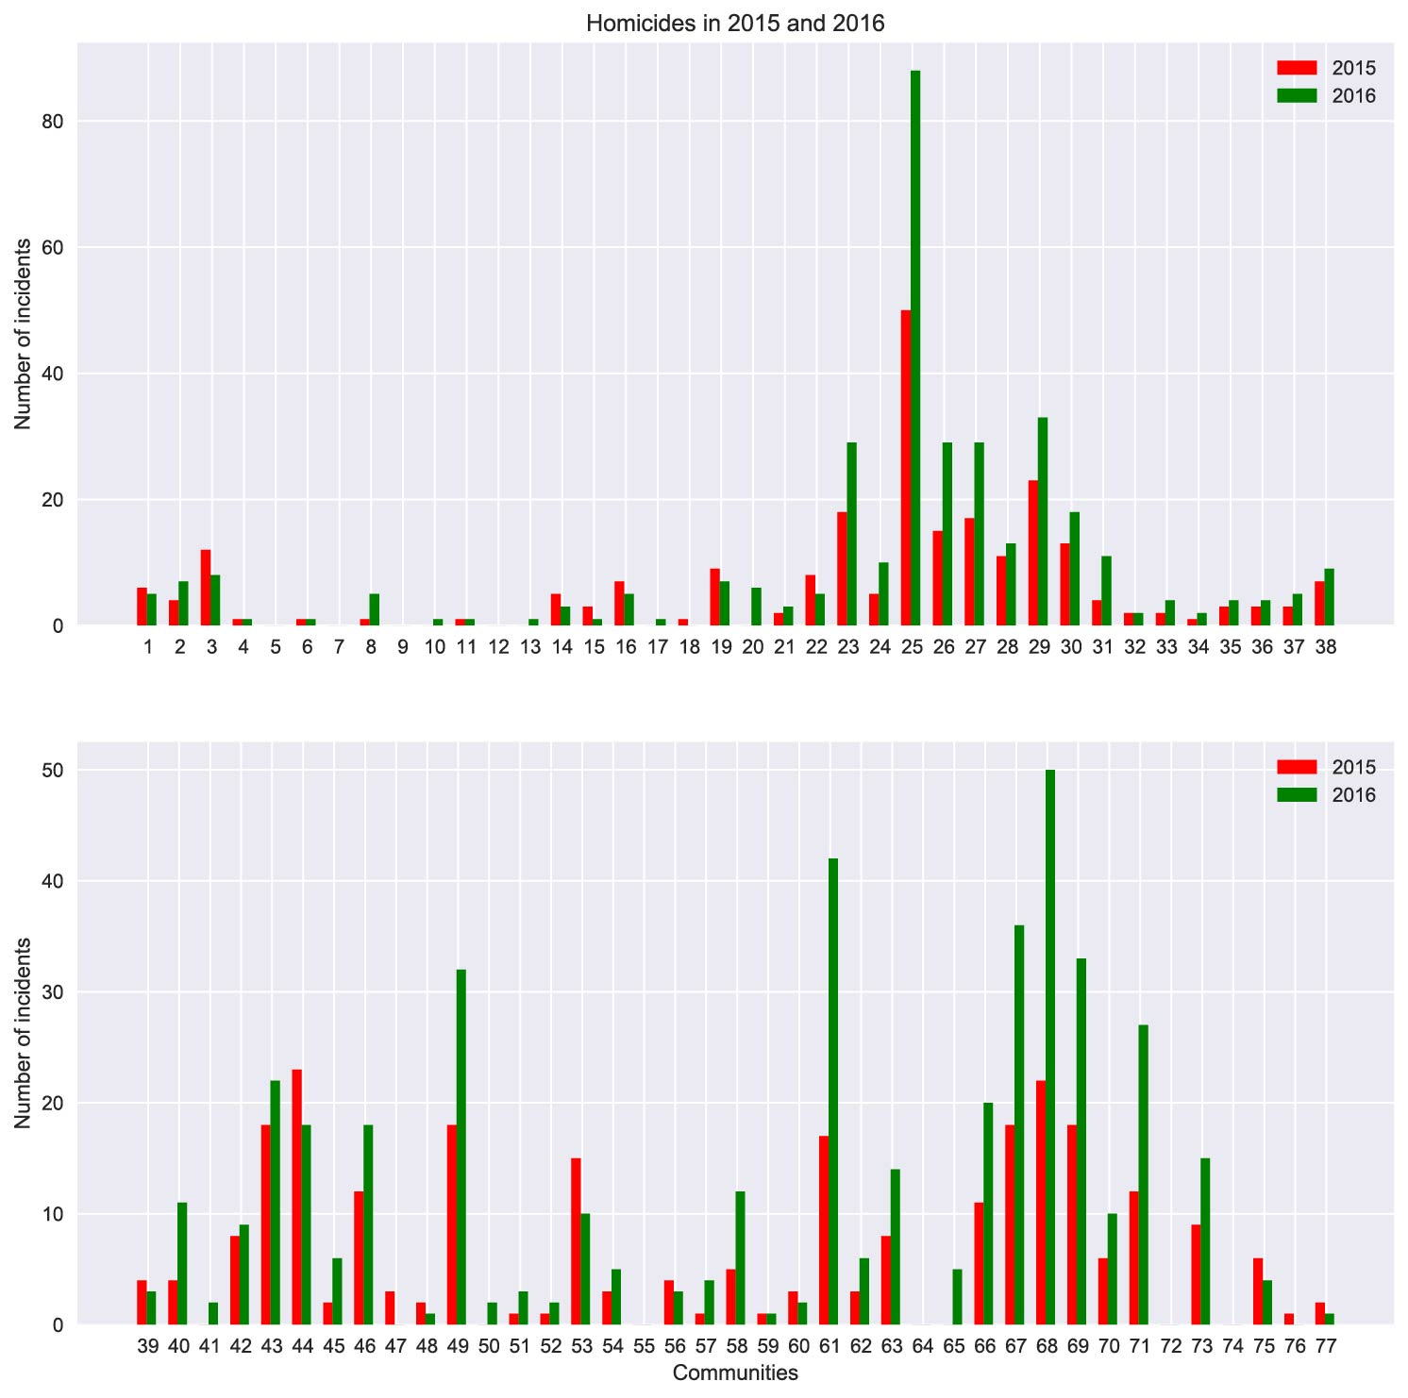
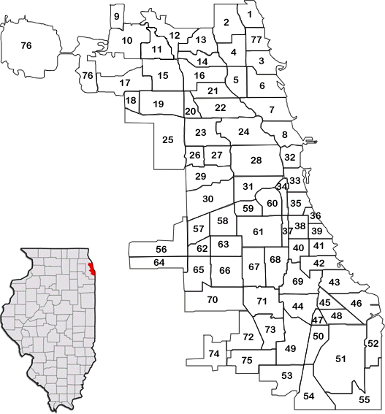
Murders happened in geographically clustered communities
Source: Social Work, Loyola, University, Chicago

Slide 11
Compare all communities

Slide 12
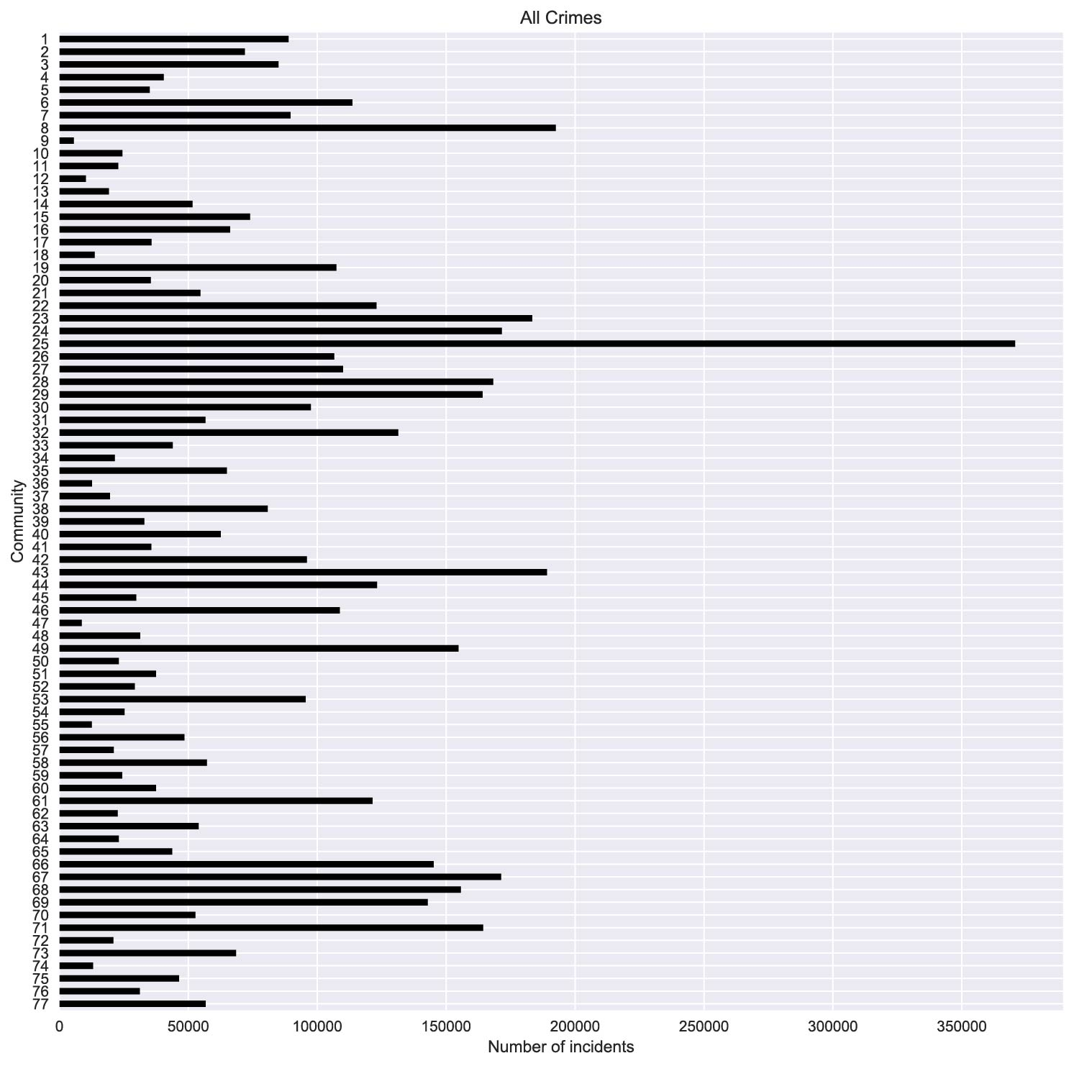
All crimes in all the neighborhoods
Top 5:
Austin (25)
Near North Side (8)
South Shore (43)
Humboldt Park (23)
West Town (24)
% below poverty level
31
12
37
32
16

Slide 13
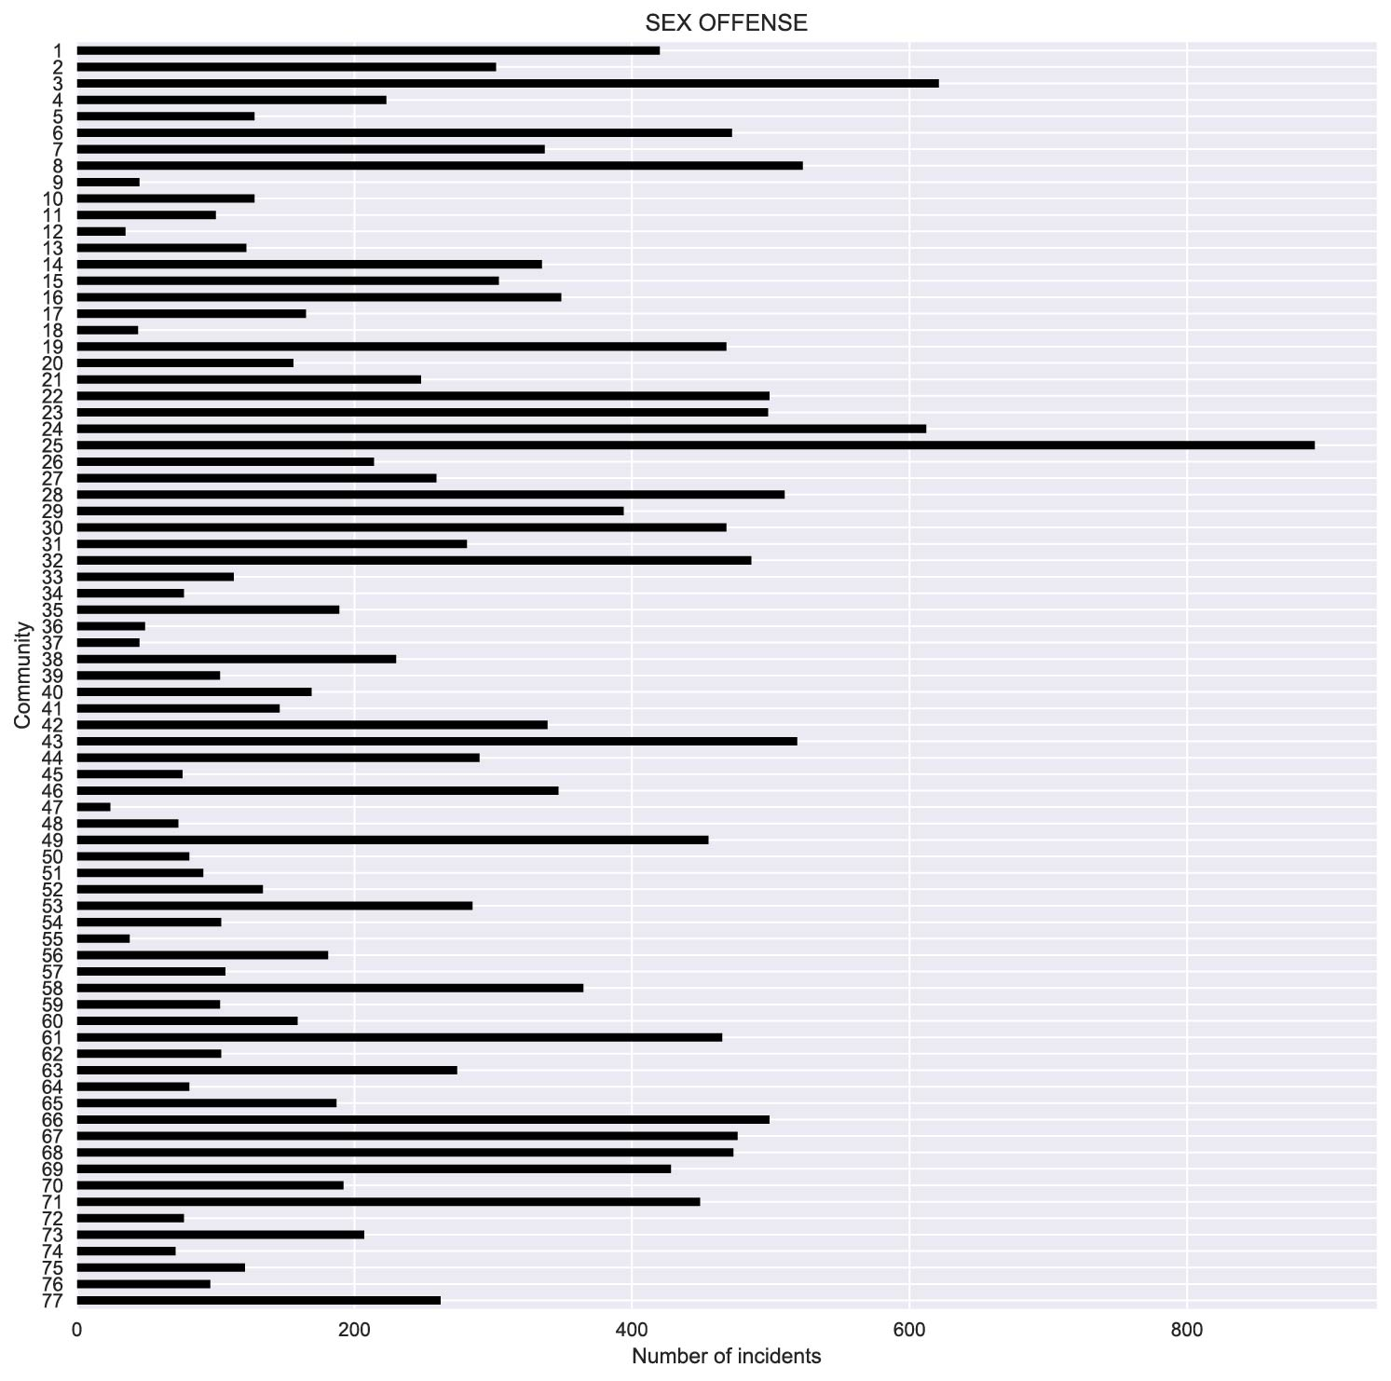
Sex offense in all the neighborhoods
Top 5:
Austin (25)
Uptown (3)
West Town (24)
Near North Side (8)
South Shore (43)
% below poverty level
31
24
16
12
37

Slide 14
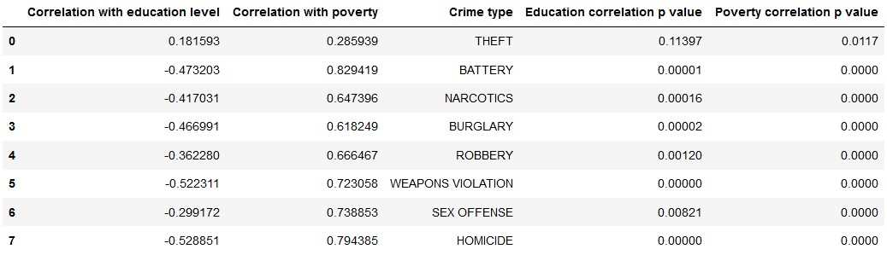
Different crime rates are correlated with poverty levels and education levels

Slide 15
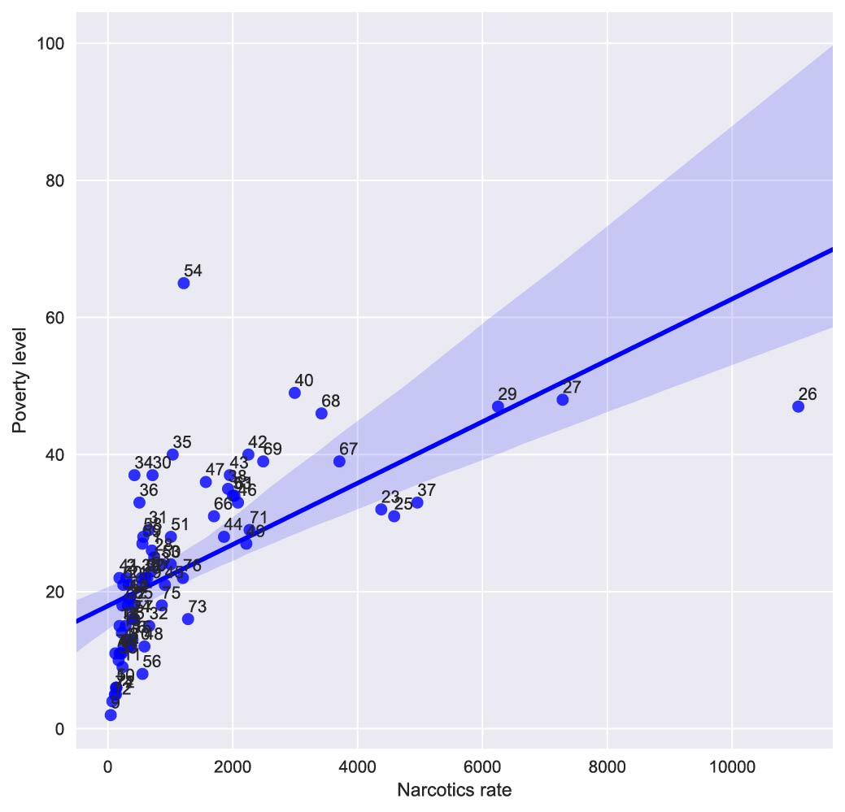
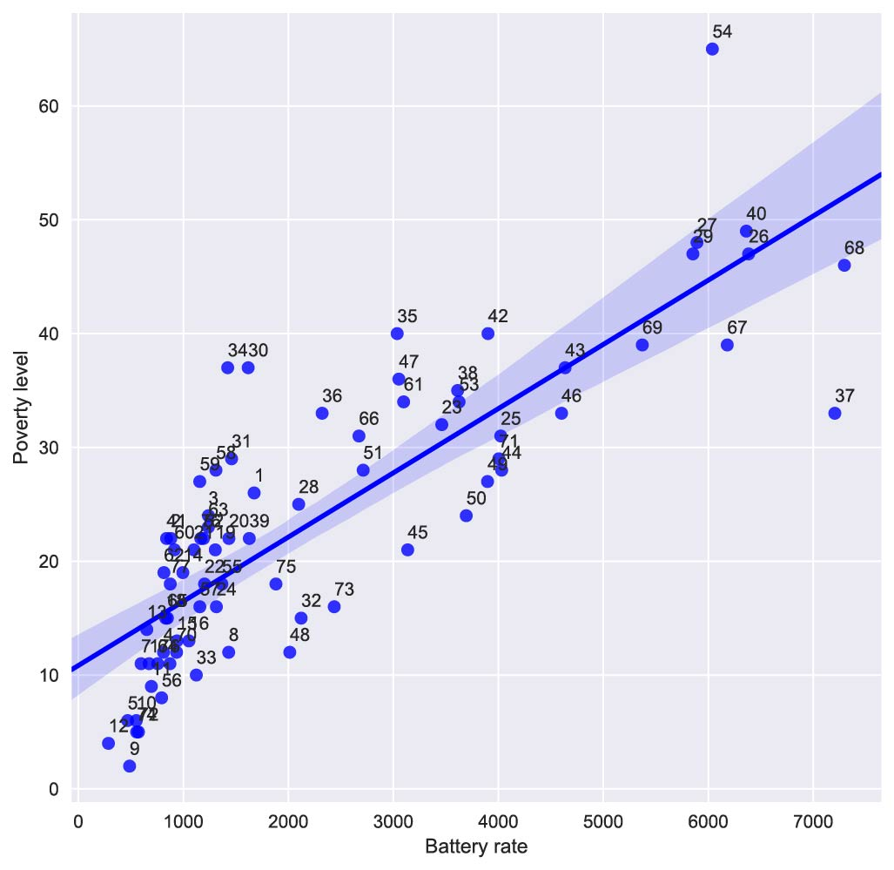
Community 54 and 32 show abnormal behaviros

Slide 16
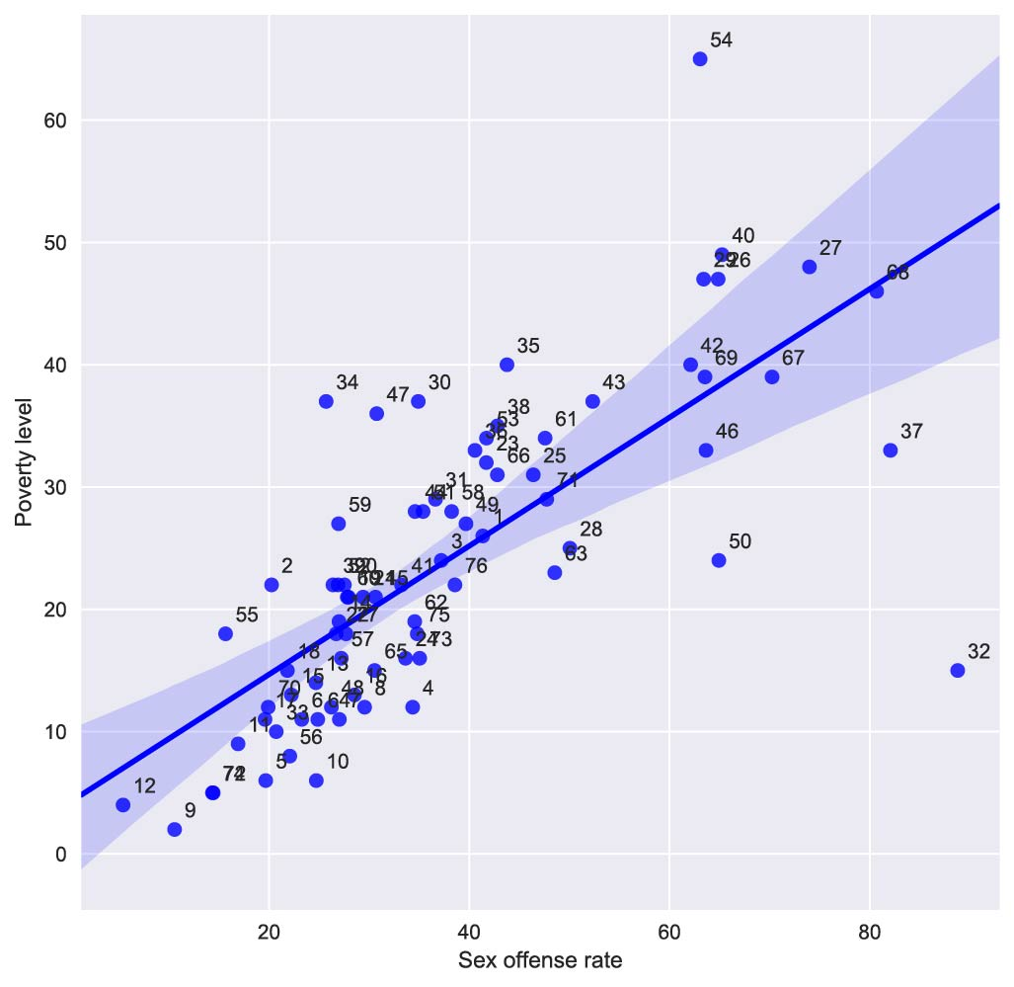
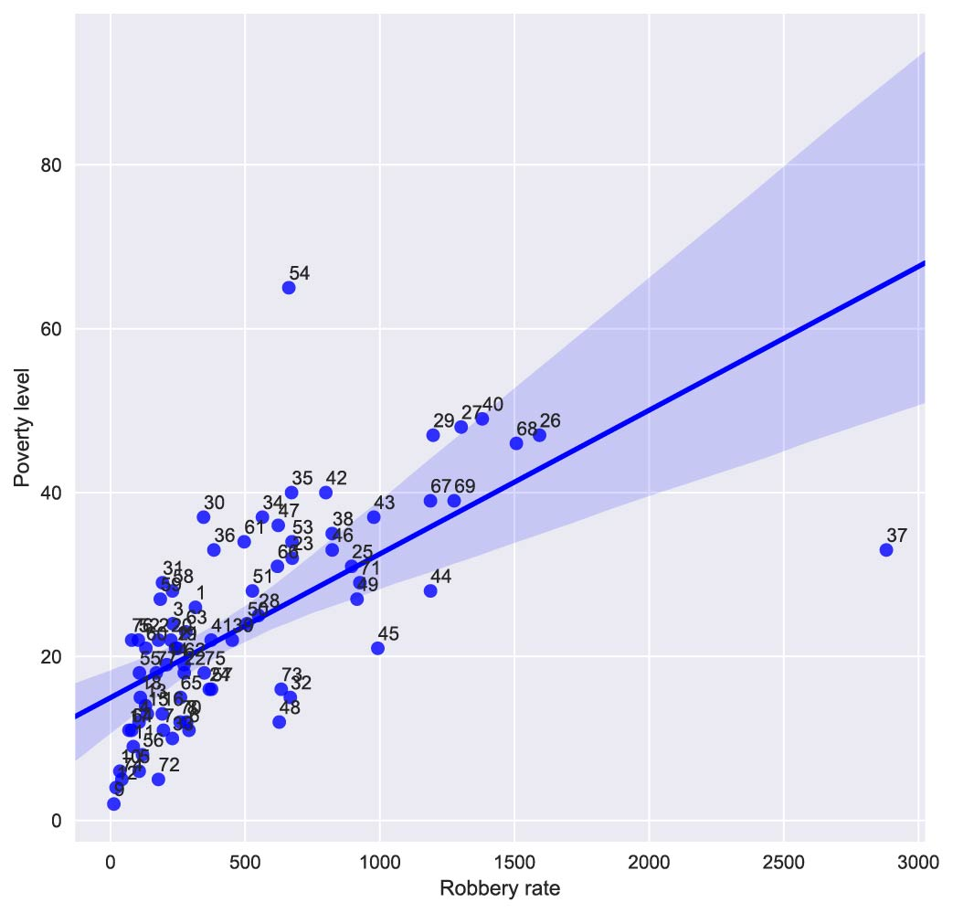
Community 54 and 32 show abnormal behaviros

Slide 17
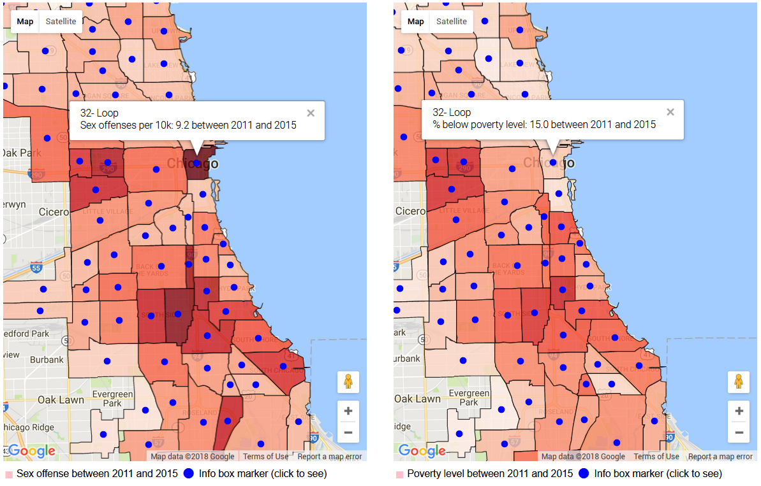
Loop had very high sex offense rate but low poverty rate

Slide 18
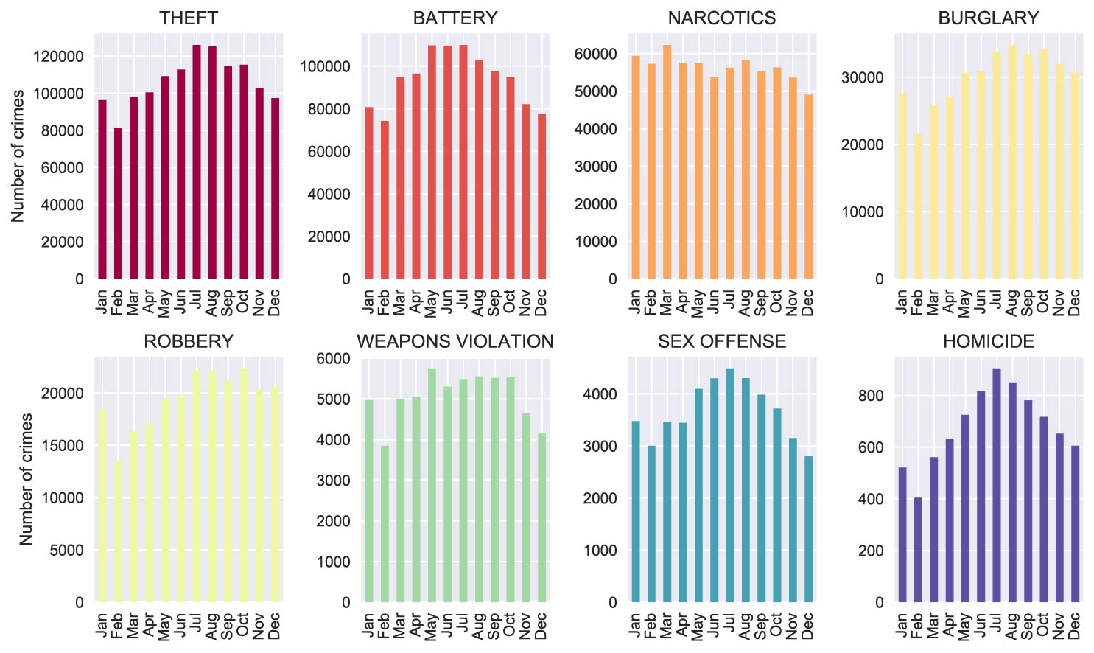
Narcotics peaked in colder months unlike other crimes

Slide 19
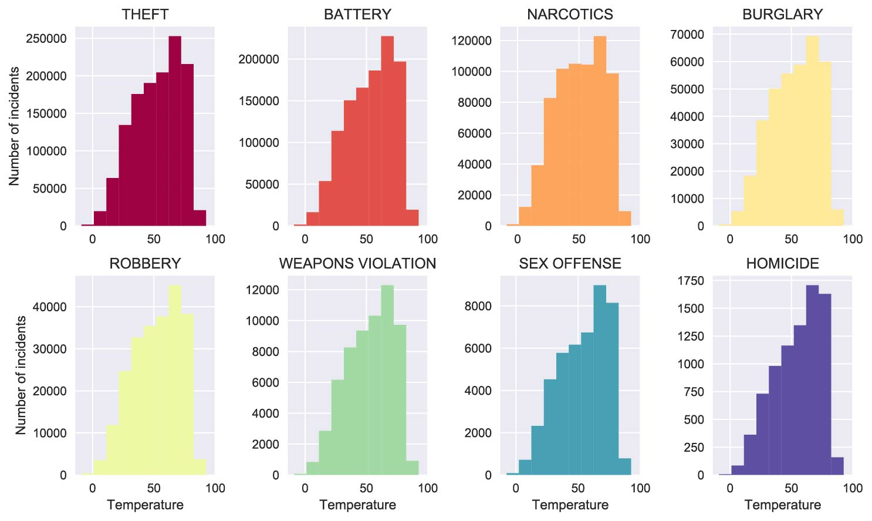
Narcotics happened in lower temperatures more

Slide 20
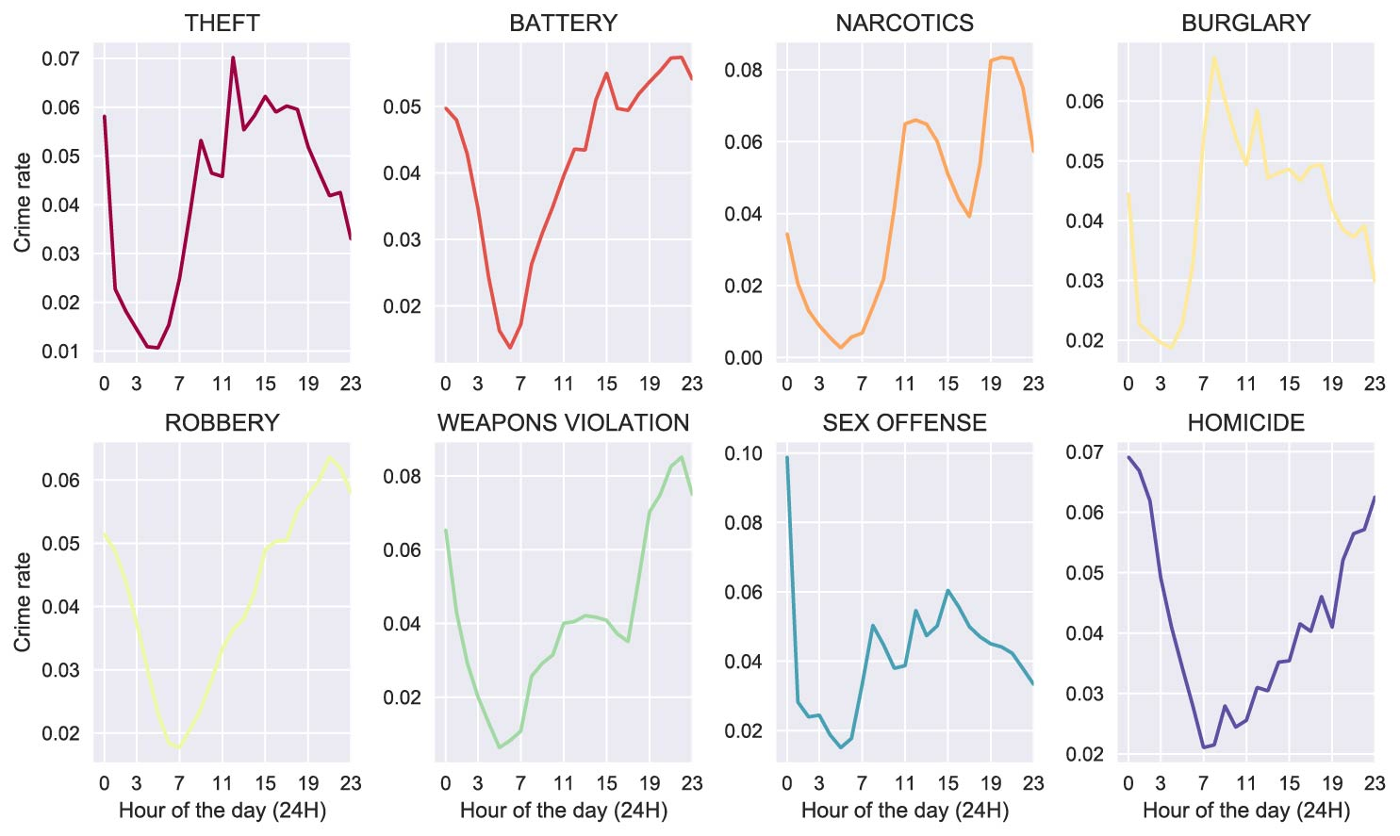
Homicide mostly happened in late hours while burglary peaked at 8 am

Slide 21
Conclusions
Overall crime rates decreased in Chicago, however, weapons violations and homicides were on the rise.
Even though most crimes tend to happen in warm weather, Narcotics were found to happen more in colder month (March).
Burglaries happened most during weekdays around 8am in the morning and lowest on the weekend. On the other hand, homicides peaked on the weekend and around 11pm while lowest during the week in day time.
Community 32, the Loop had one of the lowest poverty levels (<15%) in Chicago but there was an extremely high sex offense rate.
The West and South of Chicago are crime hot spots especially for homicides. The North area was far better in terms of totalcrimes

Slide 22
Future work
The causation between weapons violation and homicides is worth investigating. By gathering data on the cause of each homicide to see if firearms were involved could shed light on this relationship.
Look into the strange behavior of Narcotics that peaked in colder months unlike all other crimes. Maybe find the specific neighborhoods that showed this pattern and send more police officers in colder weather to these neighborhoods.
Look into association of certain crimes with public transportation to see if some crimes tend to happen more often around transit lines.
Another fact that someone could investigate was whether school closings affected crimes rates in the vicinity.
Regarding the crime type prediction, other classifiers can be tested and tuned to see if they would provide an even better model.

